Slide 1
Code Debrief
Shae & Sean

Slide 2
Services
Handles the API Calls
Places Service Example

Slide 3

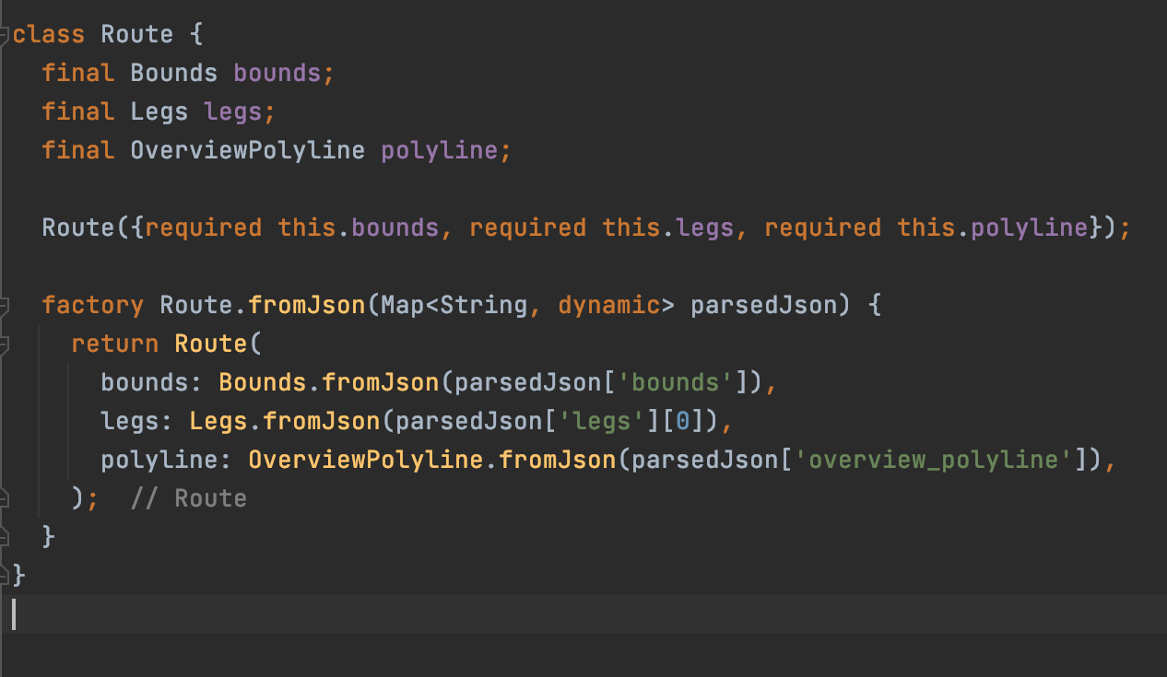
Models
Factory
Purpose

Slide 4

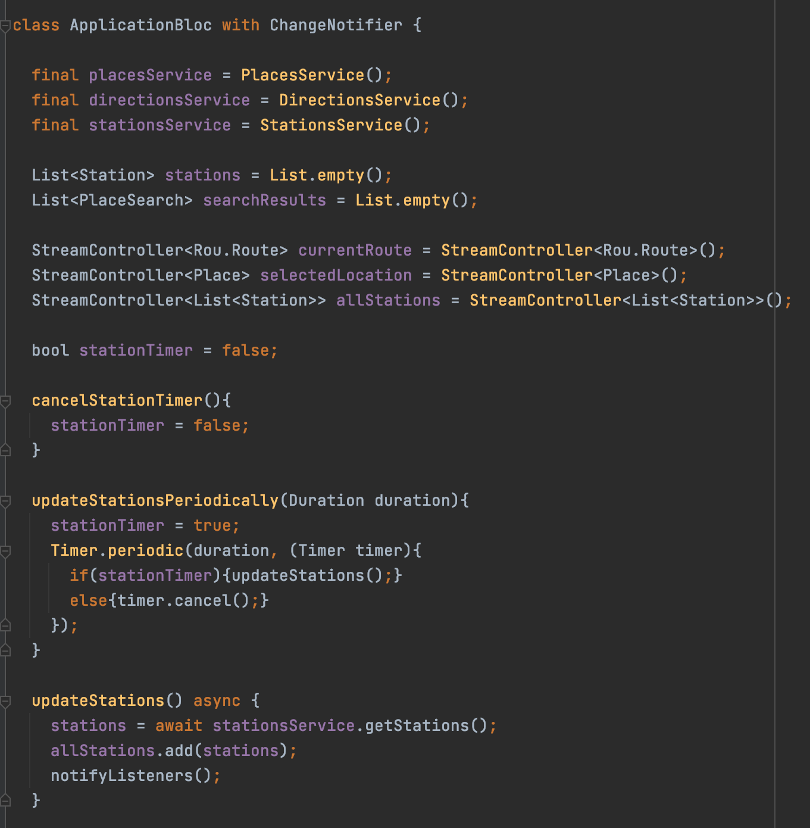
Application Bloc
Streams
Timer
notifyListeners()
Stations, Places & Route API

Slide 5
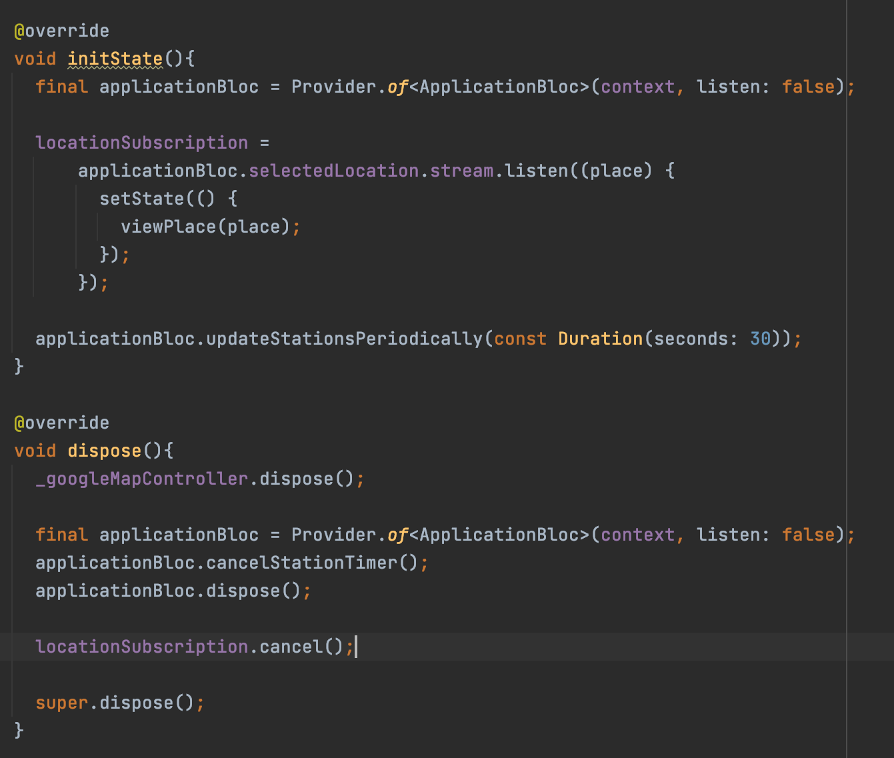
Application Bloc & Widgets
Init State
Set up subscriptions
Dispose
Cancel subscriptions

Slide 6
Managers
MVC design pattern
Managers handle the functions for widgets
Camera Manager Example

Slide 7
Widgets
Widget Class
Objects In
Widget State
Fields
Functions
Widget Function (Init, Dispose)
Widget Build

Slide 8
Home
Home
Search
Map
Station Bar
Station Card
Circle Button

Slide 9
Route Planning
Route Planning
Route Card
Search
Intermediate Stops List
ETA Card
Circle Button

Slide 10
Navigation
Navigation
Directions (potentially => Navigation Card)
Circle Button
…

Slide 11
Common Mistakes
Don’t Const User Defined Widgets
Often suggested, however causes the widget to stop updating
Multiple Stream Listeners in one Widget
Ensure the stream is denoted as a broadcast

